Slide 1
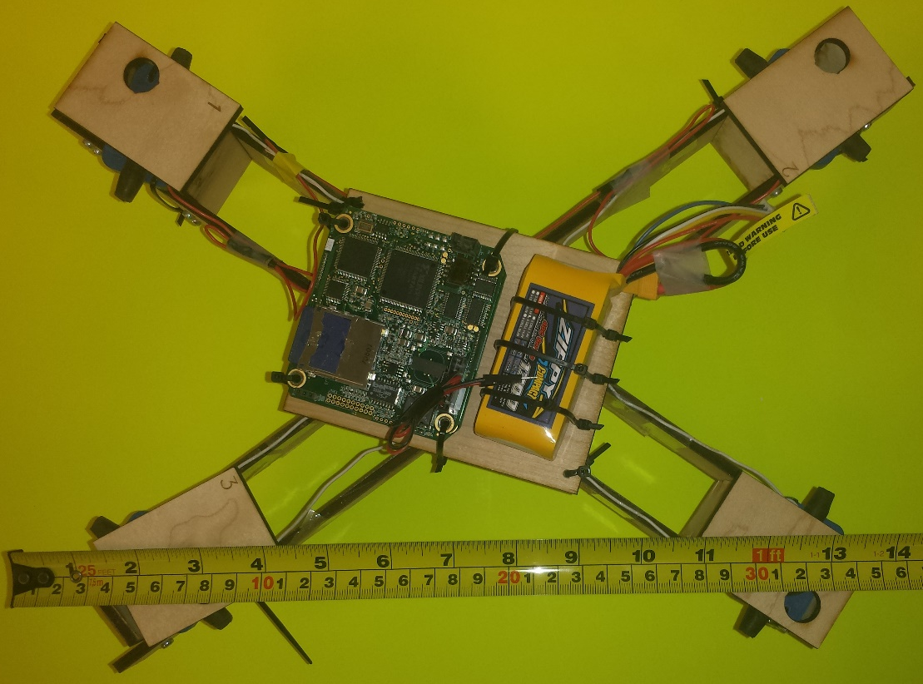
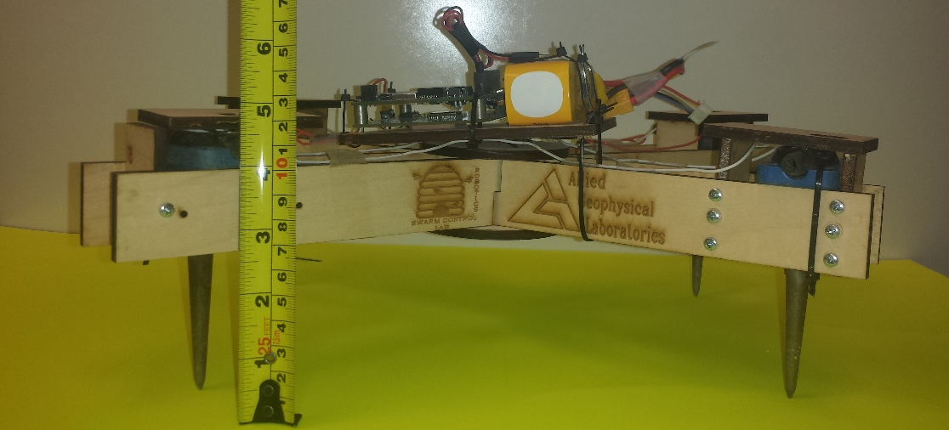
Seismic recorder (micro-controller)
Battery
Geophone Sensors
with spikes

